Slide 1

Used Cars Web scrapping and Model Building
~ Sudha Udayakumar

Slide 2

EDA from Python & Tableau

Slide 3


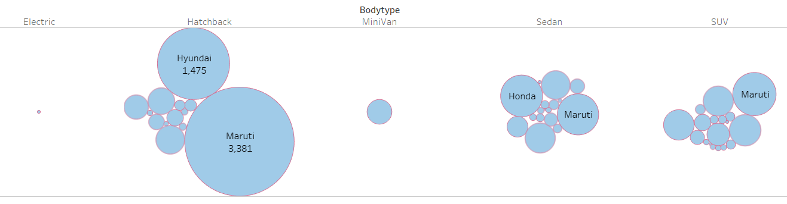

Car Brand & Body Type
Observation: Just one small circle of electric car. Harchback is higher than Sedan than SUV. Maruti and Hyundai top the list in Hatchback.

Slide 4
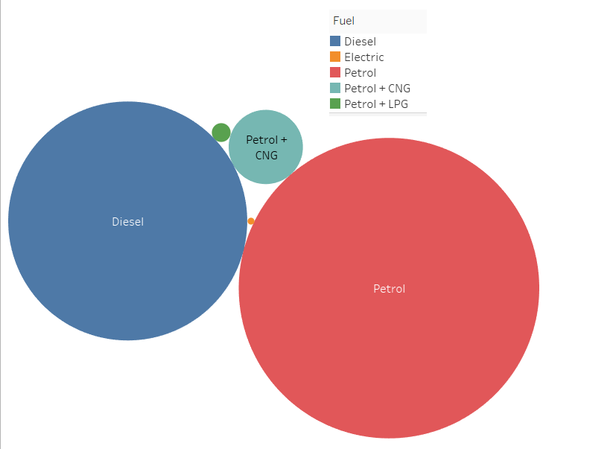
Fuel
Obervation: More Petrol than diesel cars are there. Other circles are very small

Slide 5
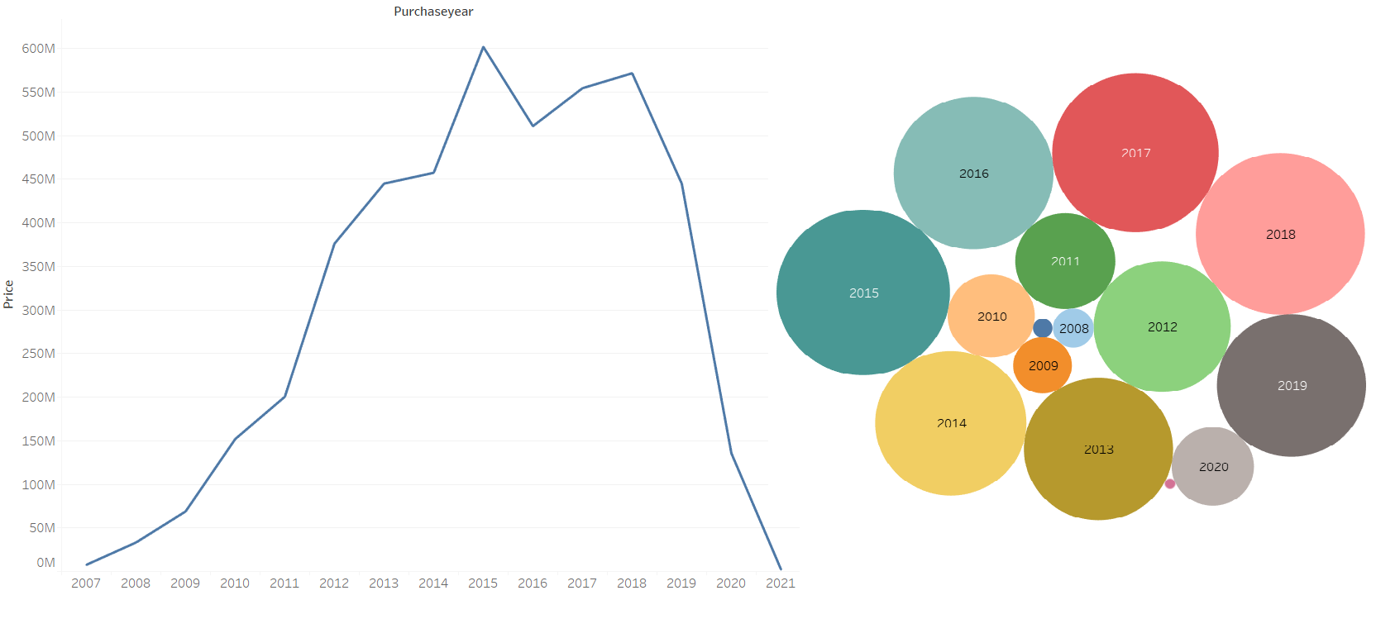
Purchase Year& Price
Observation: 2014-2018 cars are more. Cars from 2007 to the current year 2021 is avaiable

Slide 6
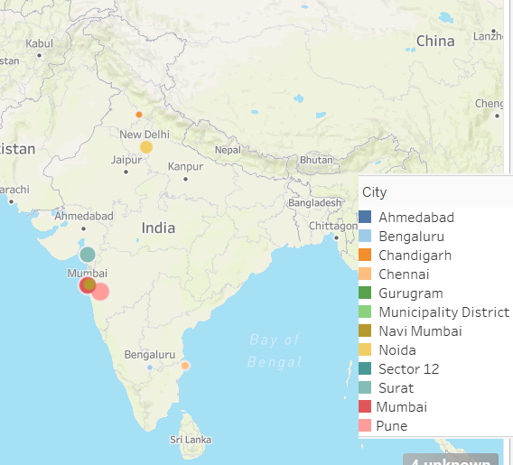
Locations
Observation: These are the locations that we have picked for our analysis

Slide 7
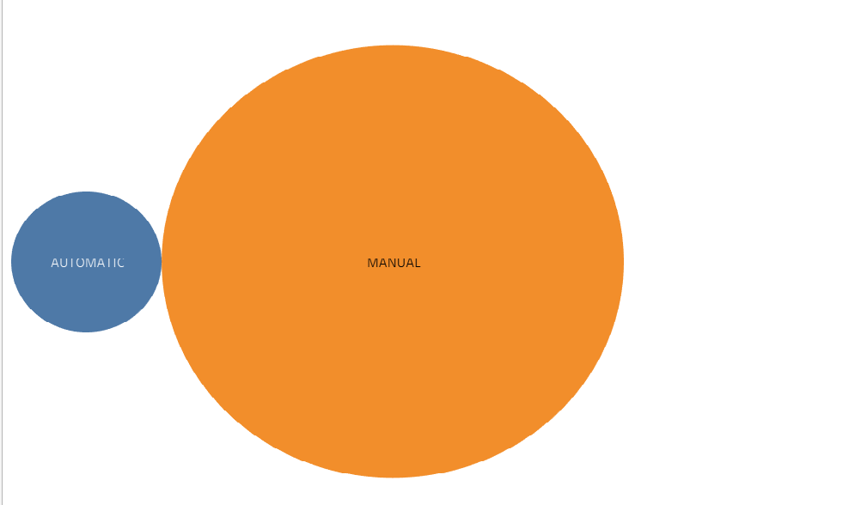
Transmission
Observation: More Manual Cars than Automatic are preferred

Slide 8
From the Word Document
INTRODUCTION
Business Problem Framing
With Covid-19 , the earlier ML models are not working. So they have to be re-created based on the current data
Conceptual Background of the Domain Problem
Understanding cities, types of car and fuel used will be helpful. Also the age of the car is very critical
Motivation for the Problem Undertaken
It is live data and the first time working on live data is very challenging and exciting.

Slide 9
Analytical Problem Framing
Mathematical/ Analytical Modeling of the Problem
Applied all the skills used in Web Scrapping, Excel, Tableau, Python and Machine Learning here
Data Sources and their formats
Used live websites to scrape data. Collected close to 10k data from cars24. Also collected 5k from other sites (OLX, Carwale, Carsandbikes). Decided to go with the Cars24 data, as there were duplicates in other data.
Data Pre-processing Done
Pre-Processing was done using Excel and Python. Excel to merge the several excel sheets, remove missing value, and clean the data. Python was used to remove the columns that are not needed, remove duplicates.
Data Inputs- Logic- Output Relationships
Price is affected by the age, brand, kms driven.
Hardware and Software Requirements and Tools Used
Python-Numpy, Pandas, Graphical support, Machine Learning. Excle, Tableau. Webscrapping-Selenium

Slide 10
Model/s Development and Evaluation
Identification of possible problem-solving approaches (methods)
Webscrapping to get good data. Collected close to 15k Rows of data and selected the websites which had suitable data
Good Pre-processing using Excel and Pandas
EDA based on Tableau and PandasModelling : We have used 7 models and 6 Evaluation Techniques (R2, RMSE, MAE, MSE, Cross validation-R2, Cross validation-RMSE). Also we found the diff of R2 & CV-R2diff, RMSE & RMSECV diff.

Slide 11
Model/s Development and Evaluation
Identification of possible problem-solving approaches (methods)
Webscrapping to get good data. Collected close to 15k Rows of data and selected the websites which had suitable data
Good Pre-processing using Excel and Pandas
EDA based on Tableau and PandasModelling : We have used 7 models and 6 Evaluation Techniques (R2, RMSE, MAE, MSE, Cross validation-R2, Cross validation-RMSE). Also we found the diff of R2 & CV-R2diff, RMSE & RMSECV diff.

Slide 12

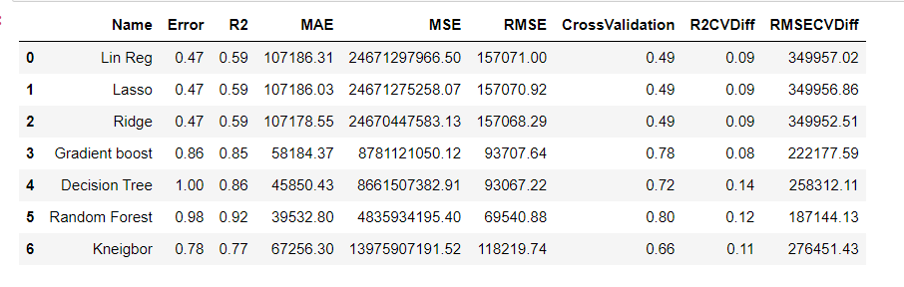

Testing of Identified Approaches (Algorithms)/ Run and Evaluate selected models

Slide 13
Key Metrics for success in solving problem under consideration/Interpretation
we generally see the R2 and CV (Cross validation diff), however we also have to take into consideration which has a better score. Here though the R2CV diff is low for linear/lasso and ridge...Random Forest is highest R2 score and cross validation score, so lets use that for our Hyper paramater tuning
All the Tableau Visualizations are captured in this deck itself

Slide 14
Conclusion-Key Findings and Conclusions of the Study
Key Findings and Observations: There is a lot of duplicate data available in the sites, as customers might be entering it multiple times
Need to do good pre-processing of data. E.g. when filtering using cities, the type of cars are not available. So those need to be manually entered.
Age can be calculated from the year of registration or year of manufacturing..
Conclusions: 92% score is a good score achieved because of the good pre-processing, handling outliers and skewness.

Slide 15
Conclusion-Learning Outcomes of the Study in respect of Data Science
Data science is not limited to one tool. Here we have used multiple tools to get the best output.
Handling Live data is very crucial and sensitive.
Suggestion given to use different jupyter files for gathering data from multiple cities was very helpful.

